Slide 1
Django Learning Log
How to use the application

Slide 2
Instructions for Admins

Slide 3
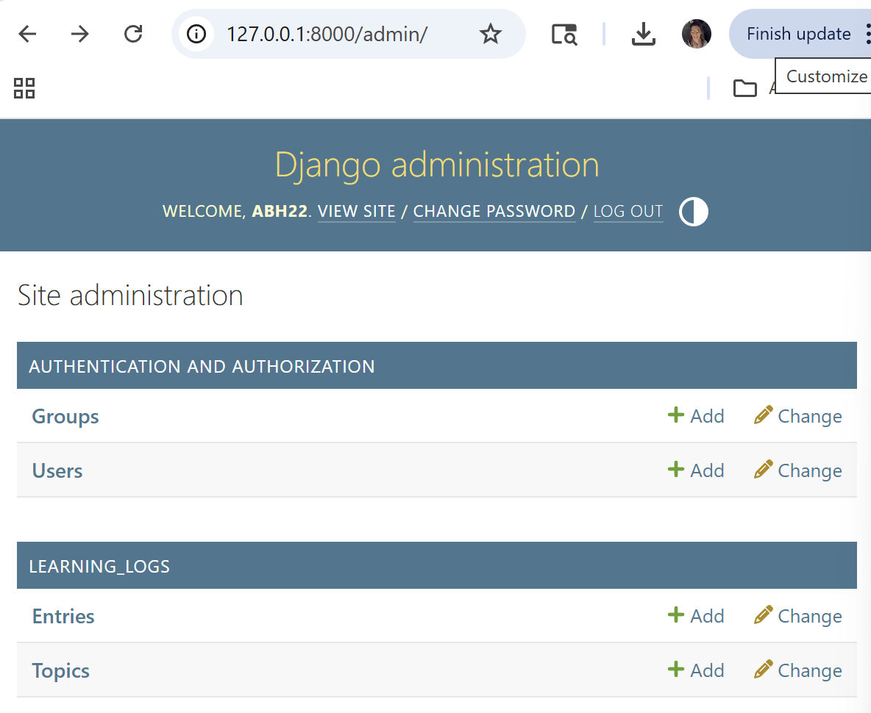
Site Administration
You will sign in on the Admin page
You will be greeted by a Welcome message
You can add or change the authorizations
Groups
Users
You can add or change the site content
Entries
Topics

Slide 4
Instructions for Users

Slide 5
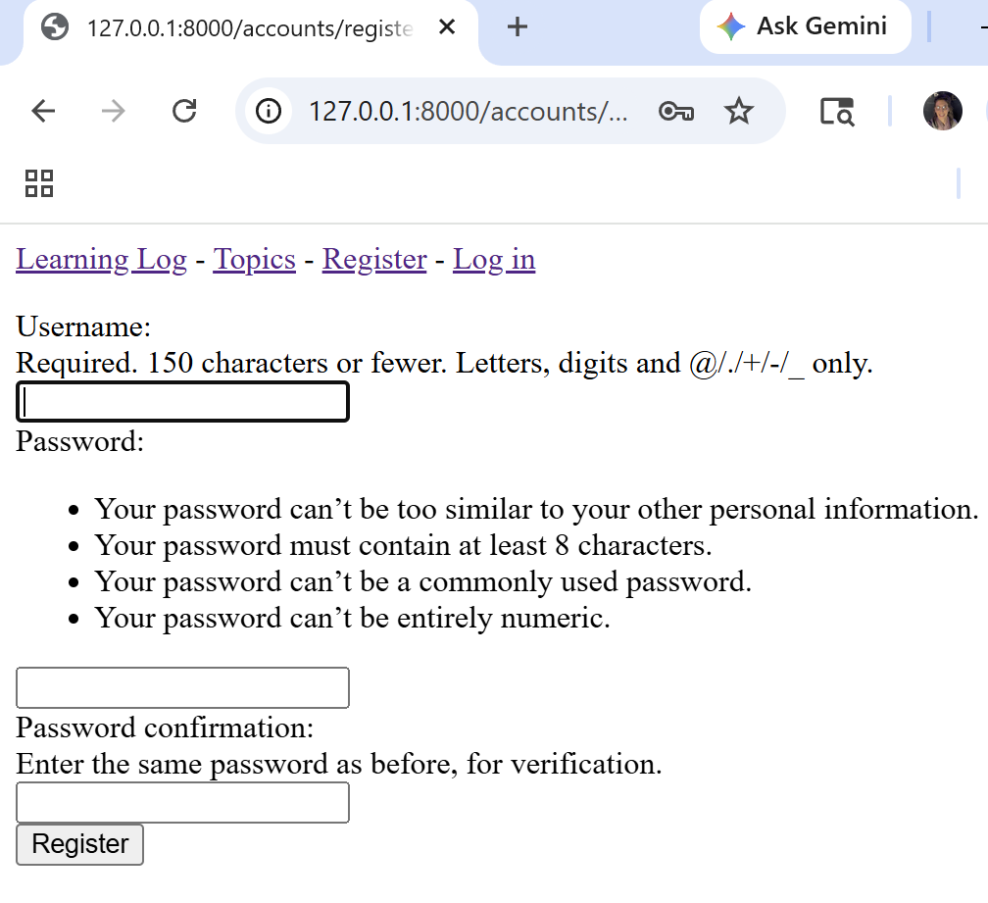
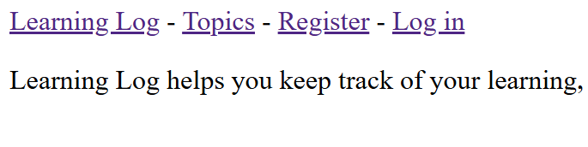
How to Get Started
Register and/or Log in:
http://127.0.0.1:8000/
This will prompt you to enter a:
Username
Password
Click on ‘Register’ at the bottom:

Slide 6
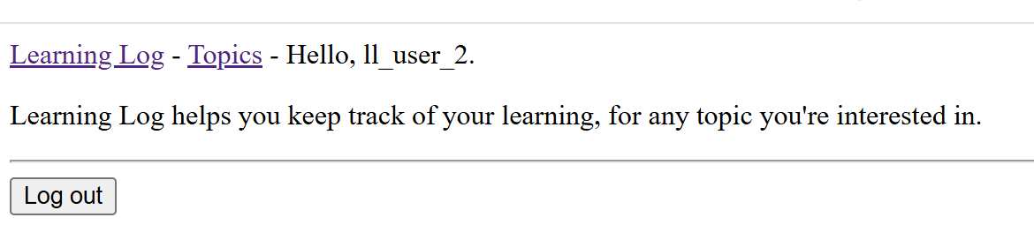
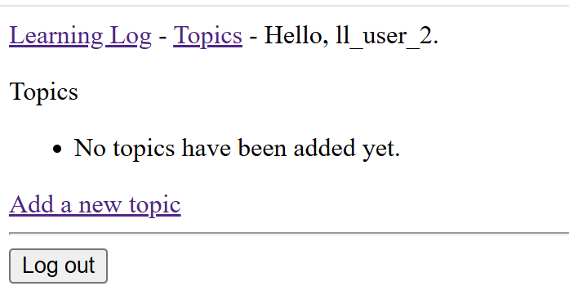
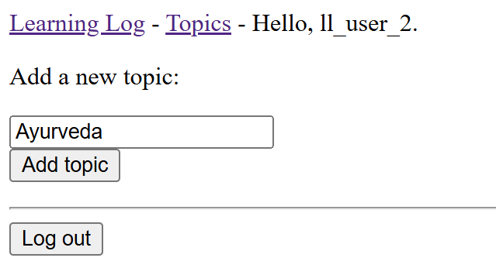
Adding information
Click on:
‘Topics’
‘Add a new topic’
Enter your topic:
‘Add topic’

Slide 7
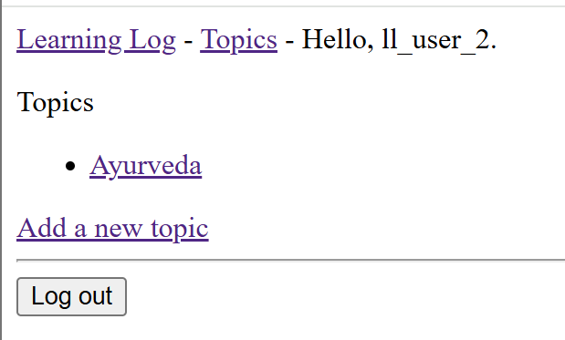
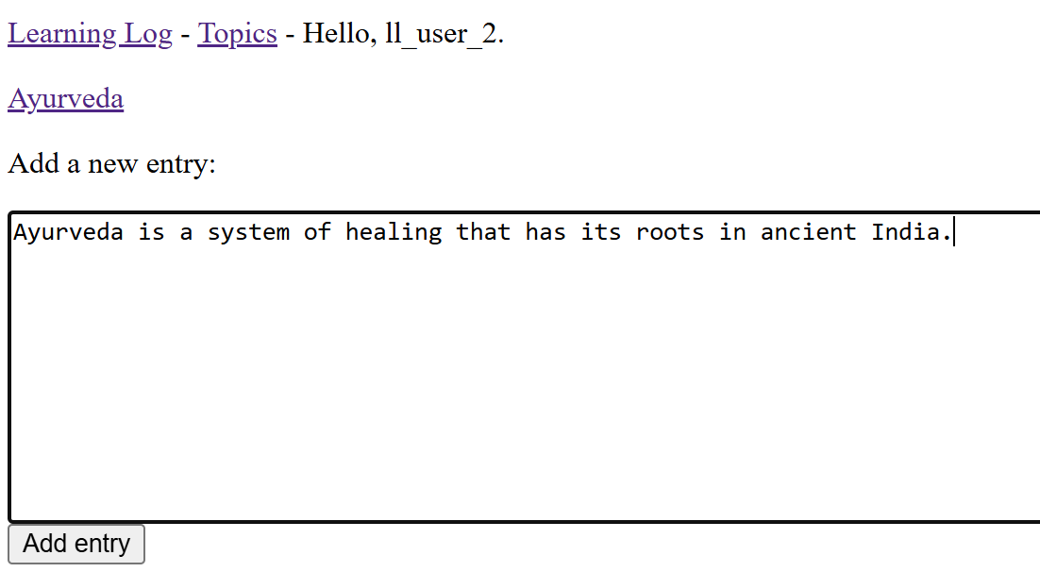
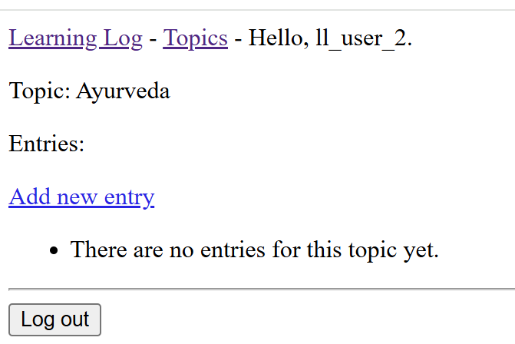
Adding an Entry
Click on your topic to make an entry
Click on ‘Add new entry.’
Click ‘Add entry’ to save.

Slide 8
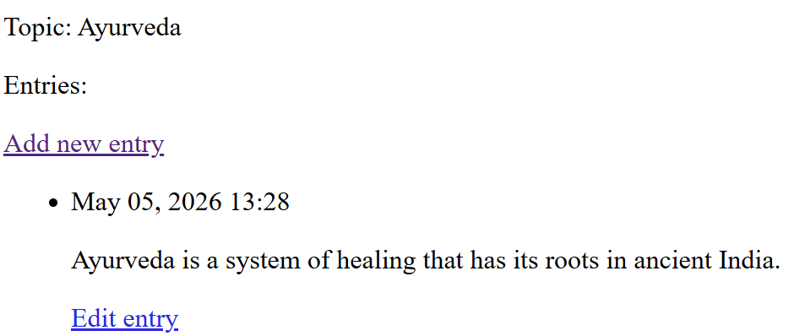
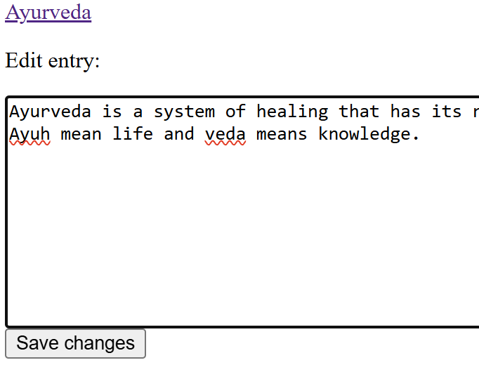
Edit an Entry
In your Topics page, click:
‘Edit entry.’
Edit your entry and then click:
‘Save changes.’

Slide 9
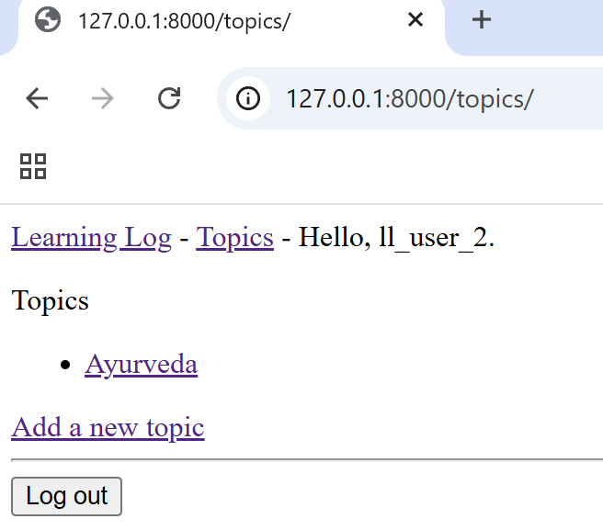
Logging out
At the bottom of the screen is the ‘Log out’ button.
Click this when you are finished and ready to exit.

